Slide 1
A Journey Into Vector Tiles
Dave Barter
dave@nautoguide.com
@citizenfishy
CEO – Nautoguide Ltd.

Slide 2
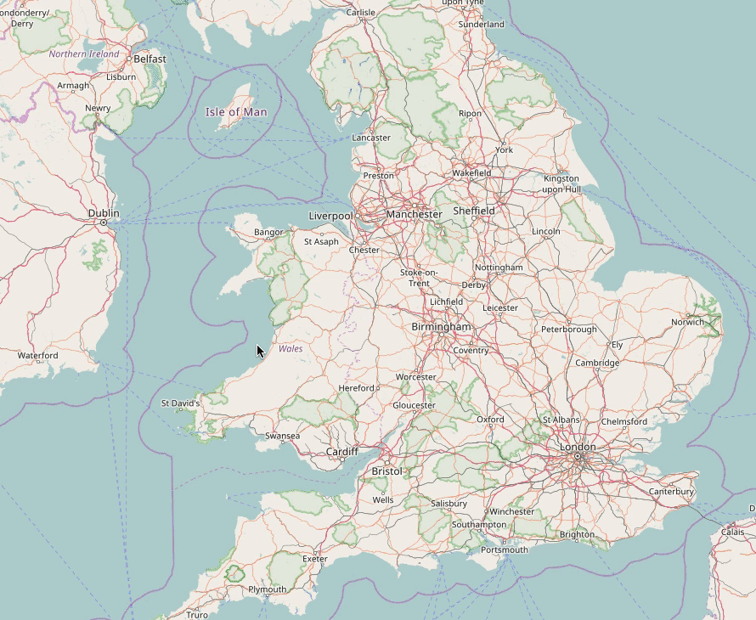
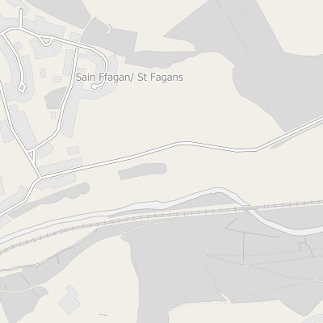
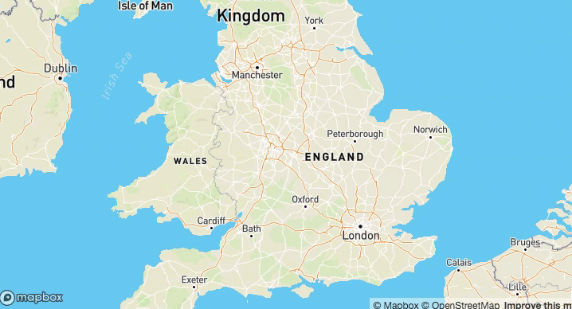
Vector Tiles
layers {
version: 2
name: "points" features: { id: 1 tags: 0 tags: 0 tags: 1 tags: 0 tags: 2 tags: 1 type: Point geometry: ... } features { id: 2 tags: 0 tags: 2 tags: 2 tags: 3 type: Point geometry: ... } keys: "hello" keys: "h" keys: "count" values: { string_value: "world" } values: { double_value: 1.23 } values: { string_value: "again" } values: { int_value: 2 } extent: 4096 }
Smaller
Client Side Styling
Faster (WebGL)
Overzoom

Slide 3
Using Vector Tiles
Data from:
Mapbox Studio
https://openmaptiles.com/downloads/planet/
Mapbox - https://www.mapbox.com/
Openlayers – https://openlayers.org/
Leaflet – https://leafletjs.com

Slide 4
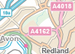
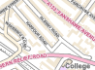
Vector Tiles from OS Opendata
Get tippecanoe
Download Opendata
Collate and convert to GeoJSON
Render to PBF tiles
Serve tiles
Style layers
Strategi + Open Map Local
tippecanoe –Z 0 –z 15 \
-L buildings: building.geojson
-L ……
-L ……
-o opendata.mbtiles
find . -name "*_Building.shp" -exec ogrtindex -f "ESRI Shapefile" openmap_building_tindex.shp {} \;
ogr2ogr -f GeoJSON -s_srs EPSG:27700 -t_srs EPSG:4326 building.geojson openm I've committed a change with two buttons if you could style or replace those for me then that is job done. I'm using them to switch between map stylesThanks ap_building_tindex.shp
{minzoom: 0, maxzoom: 10}
docker run -it -v $(pwd):/data -p 8080:80 klokantech/tileserver-gl

Slide 5
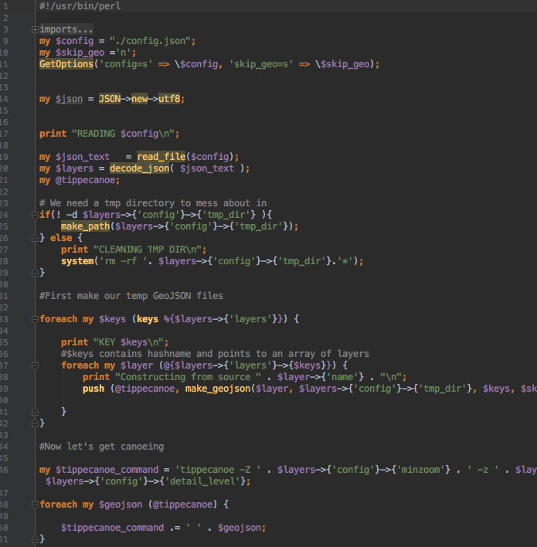
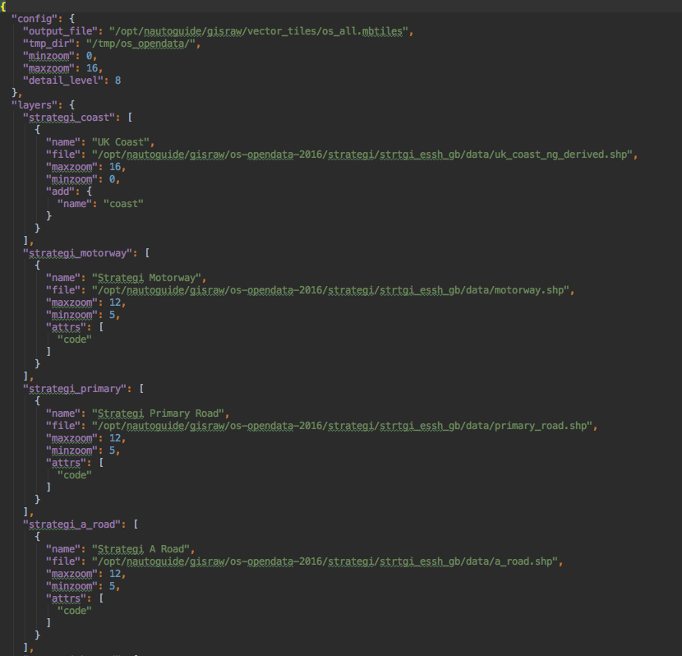
My Gift to You

Slide 6
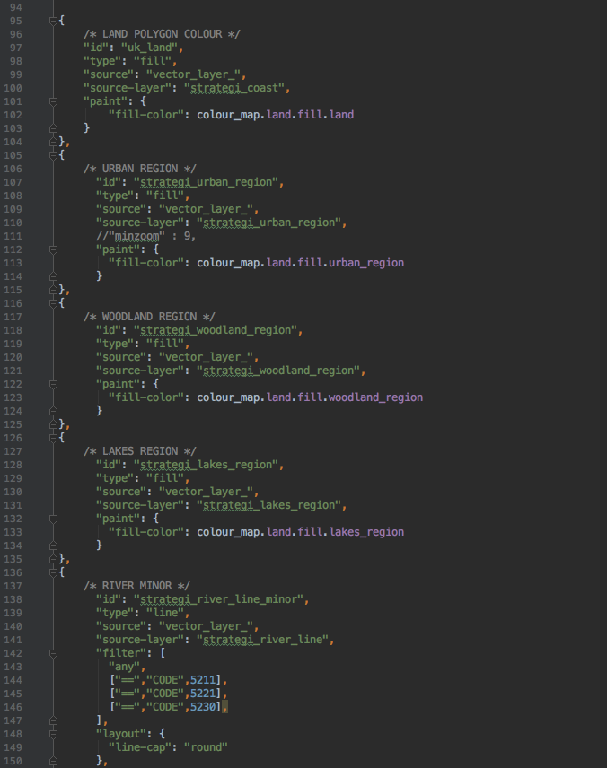
Layer Styling (Mapbox GL)
Where we’re at now
https://github.com/citizenfish/os_vector_tiles

Slide 7
A Journey Into Vector Tiles
Dave Barter
dave@nautoguide.com
CEO – Nautoguide Ltd.

